Slide 1
Voice Authentication
Problem Statement
Authentication measures of Caller ID / PIN (personal identification numbers) / Security Questions / Device Signatures are sometime inadequate and intrusive. Identify creative methods of Customer Authentication which can be used on various channels. This should be done without deteriorating the customer experience.

Slide 2
Voice Biometrics Verification
Once the user’s voiceprint is captured and stored in the system, it is used to verify the user. During the authentication process, the user needs to talk. The voice biometrics system captures the voiceprint and verifies whether the voiceprint matches with the template on its database.
Types of Voice Biometrics Authentication
Active Voice Biometrics
Passive Voice Biometrics
Verification Parameters:
Time taken to authenticate
Data Volume
Security

Slide 3
Technical skills
Technology needs to be implemented for Voice biometric verification
Front end Technical skills
Angular
Wpf
Back end Technical Skills
Asp.net core web api,C#
Azure Cognitive Services(AI)
Azure Cosmo DB
Hadoop/Big Data(Optional)

Slide 4
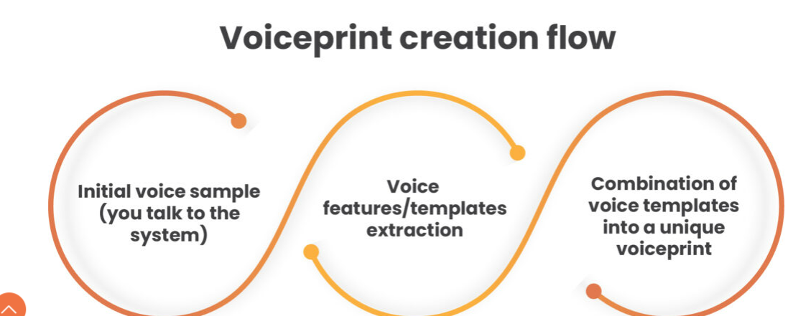
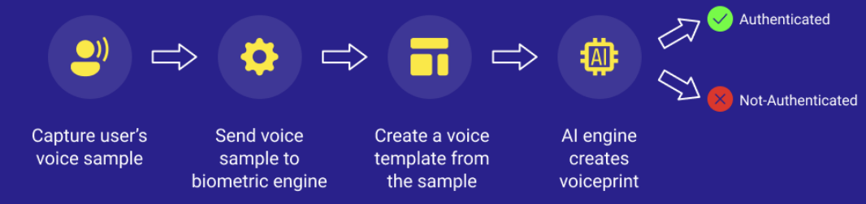
How does voice biometrics work?

Slide 5
Voice Authentication Technical work flow
Authentication with User ID and Password with additional factor of voice authentication(MFA)
Web api Service layer endpoint with parameters with Voice and User Id and password.
Voice print stored in Azure cosmo db/Hadoop
SSL layer with HTTP protocol communication with server
Password
Verified
Multi factcor Authentication
Voice verification
Verified
User Interface Login
User Id
Azure Cosmo DB
Web api
Azure AI

